Slide 1
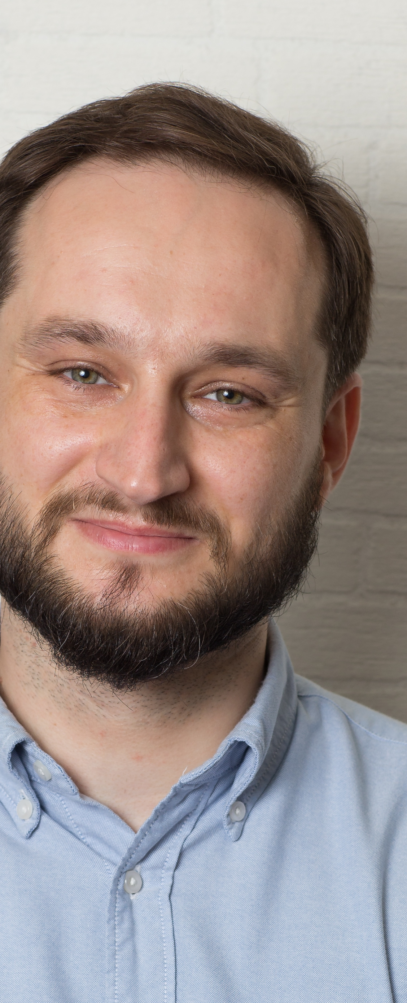
HELLO!
I’m Tomasz Zawada
Let me tell you about a couple of events I have organized for various companies

Slide 2

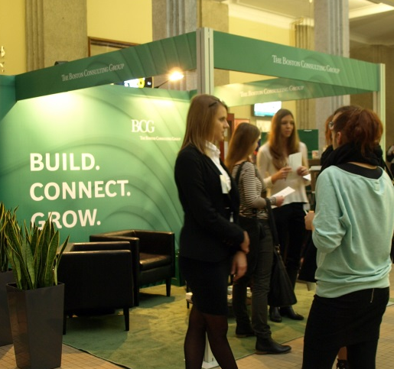
Capgemini
IT T@lk - series of informal events I have made in several locations in Katowice to promote Capgemini as a company of choice for IT experts.
Target audience: experienced IT professionals in the Upper Silesia region. Approximately 70 participants per event, on average they had 8.5 years of work experience.
My responsibilities: event promotion, media buying, cooperation with media partners and suppliers, on-site coordination.

Slide 3
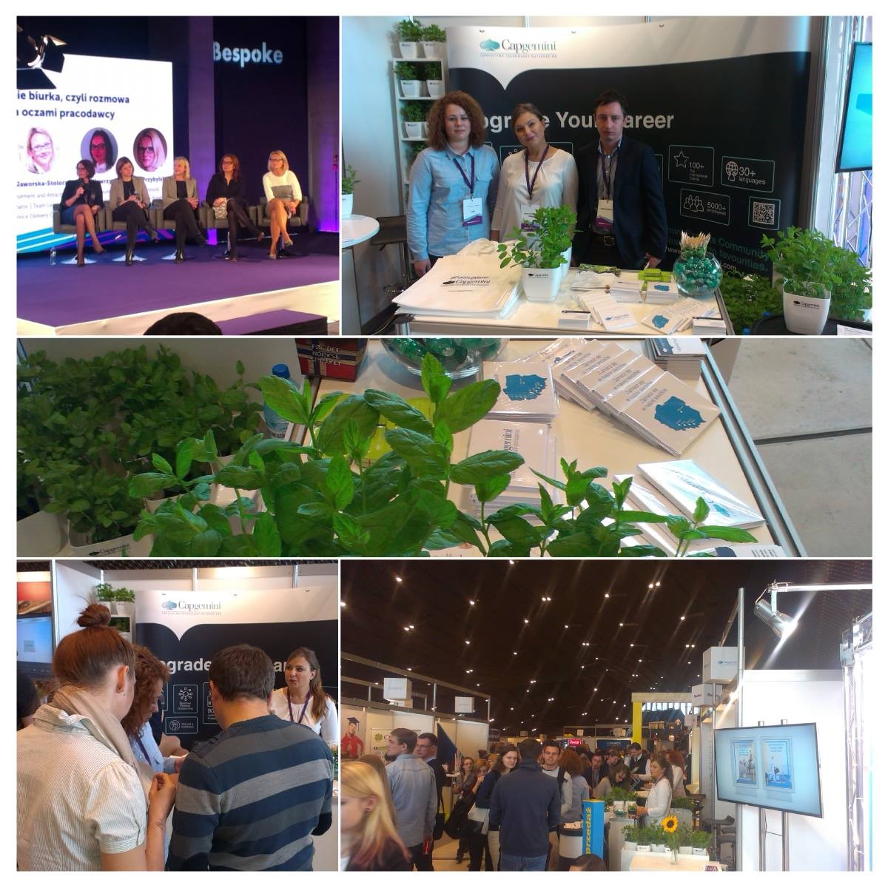
Capgemini
A multichannel campaign involving outdoor, aroma marketing, online marketing, events at universities and job fairs.
The main slogan, “Poczuj miętę do Capgemini”, literally translates into “Feel the mint for Capgemini” which is a Polish idiom that stands for being attracted to someone.
Two awards received for this campaign: Brązowy Spinacz and ABSL Diamonds.
My responsibilities: executing the project, online campaign and events.
More information in English

Slide 4
The Boston Consulting
Group
5 events promoting a case study competition for students at selected universities (Warszawa, Kraków, Poznań, Wrocław, Łódź).
2-day event for the winners (20 people) held in a luxury hotel with various soft-skill trainings and celebrity motivational speaker, celebrity chef, whisky tasting, salsa classes.
Budget >40,000 USD
My responsibilities: managing the project, contacting vendors, promoting events, on-site coordination.

Slide 5
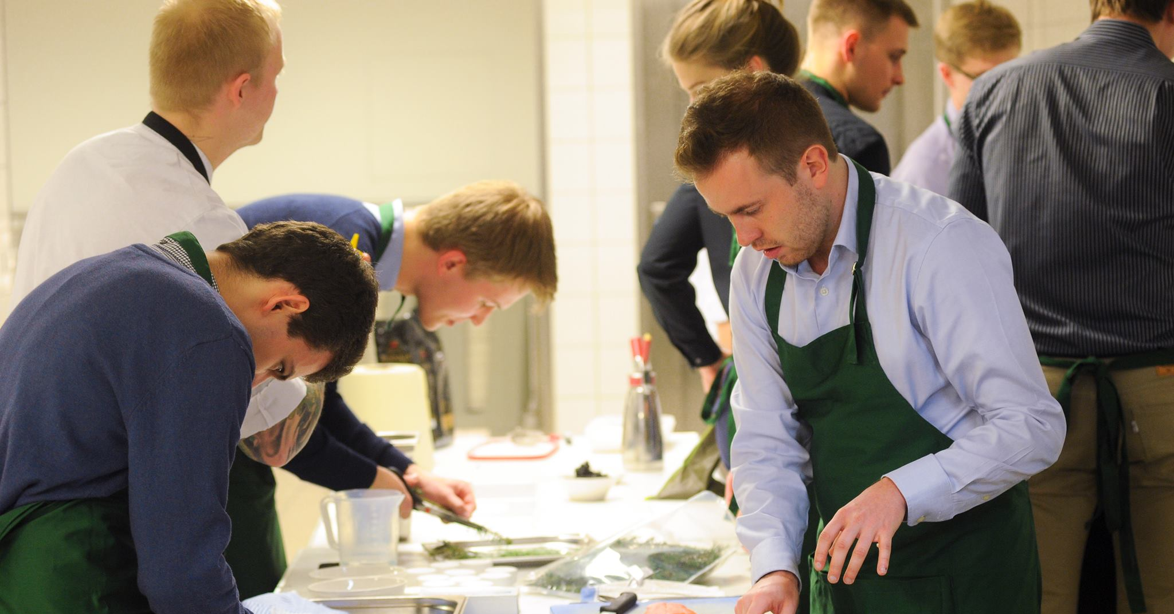
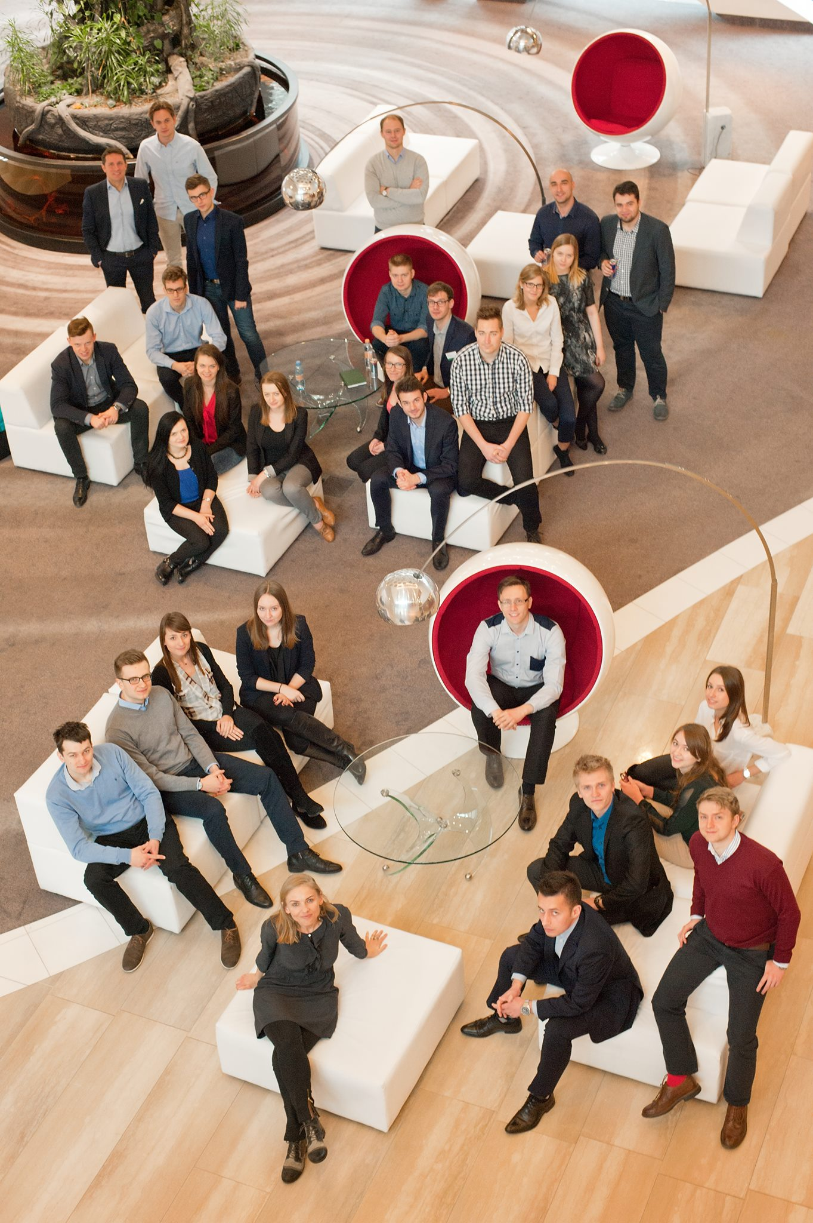
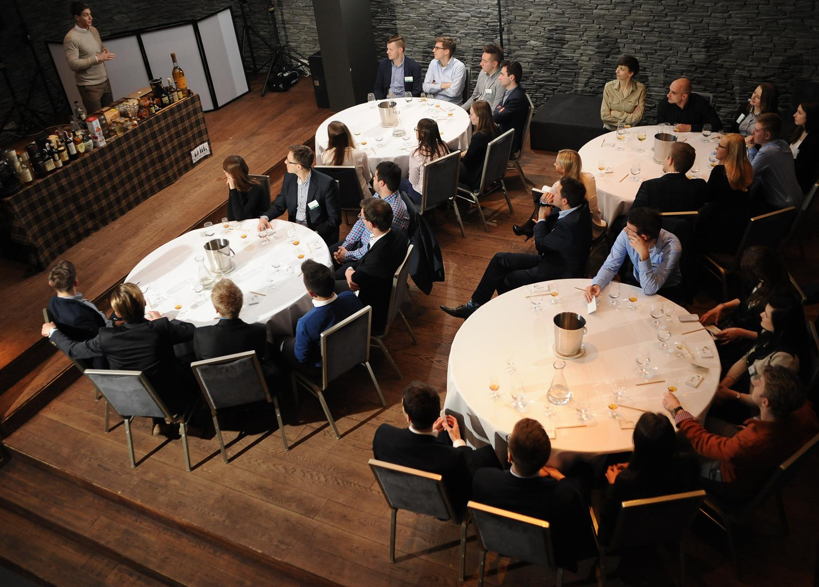
The Boston Consulting Group

Slide 6
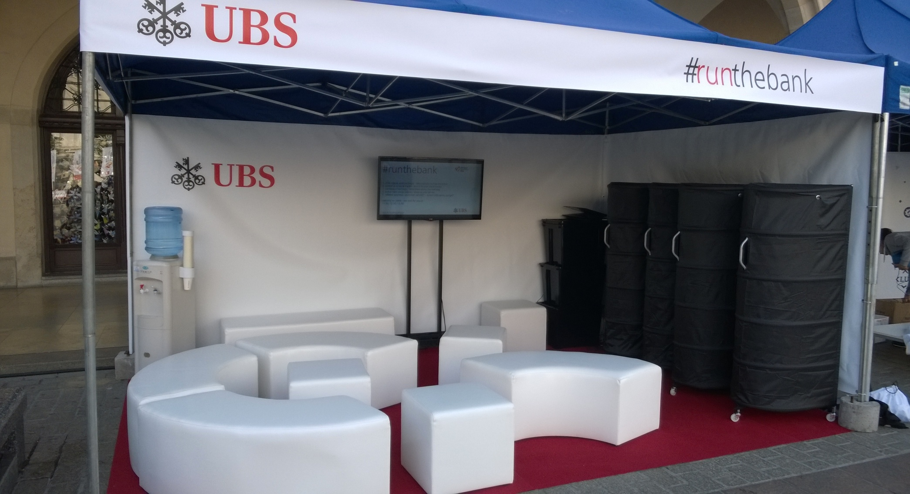
UBS
Organizing client’s presence on Krakow Business Run – the biggest Polish charity run.
My responsibilities: managing the project, contacting vendors, logistics, media relations, on-site coordination.

Slide 7
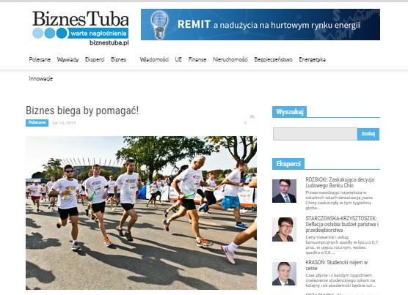
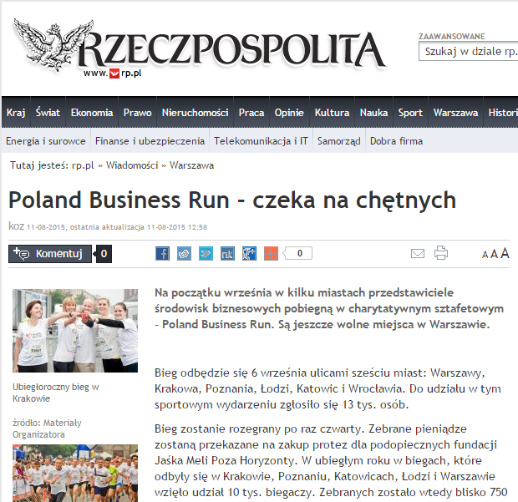
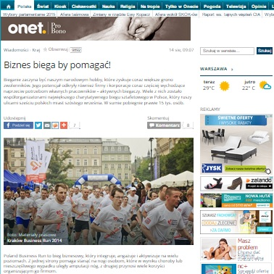
UBS

Slide 8
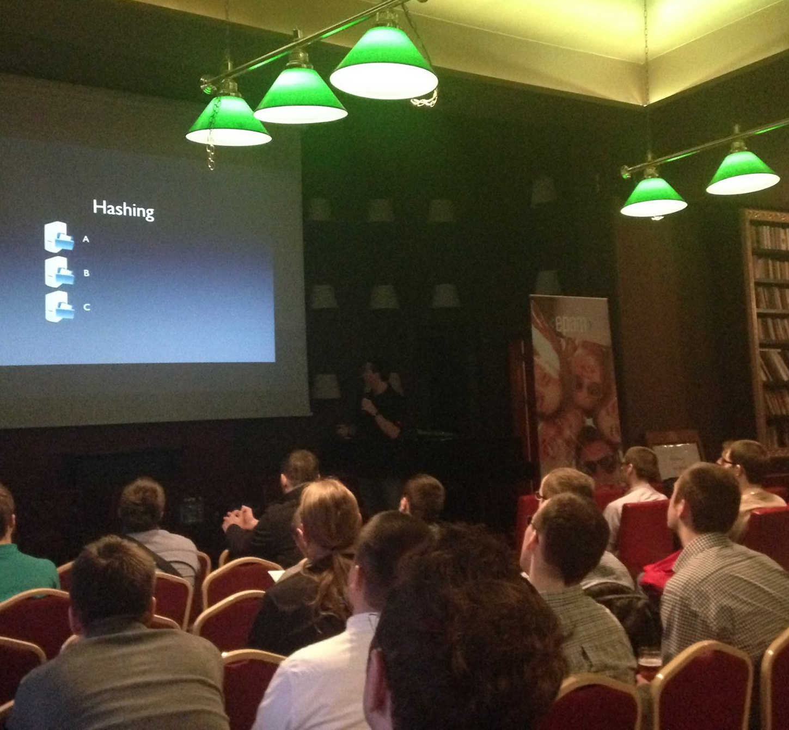
EPAM
Organizing two meetups on very short notice (two weeks).
My responsibilities: arranging appropriate venues, ordering gadgets, taking care of keynote speakers, online campaigns, contact with IT communities to promote the event, managing the project, contacting vendors, logistics, media relations, on-site coordination.

Slide 9
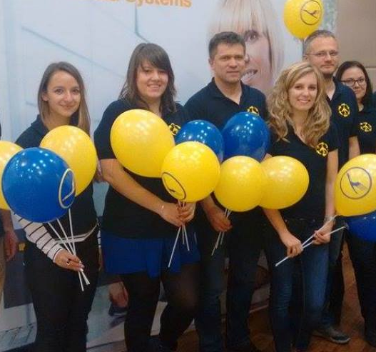
Lufthansa Systems
Organizing lecture at Rzeszów University of Technology (aviation) and recruitment event (aviation and IT).
Despite the short campaign over 30 Java developers attended the recruitment event. Half of them went through to the next stage of the recruitment process, two of them got the offer right away.
My responsibilities: managing the project, contacting vendors, logistics, media relations, on-site coordination

Slide 10
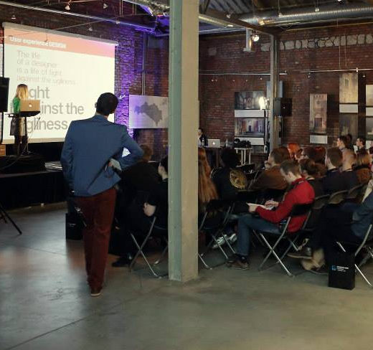
Avanade
The Way Forward Conference organized by Avanade (formerly Infusion).
2015 edition was first in this series and yet it gathered around 120 people.
My responsibilities: promoting the event (including online campaign, social media and cooperation with IT communities).
Please see more photos and video.

Slide 11
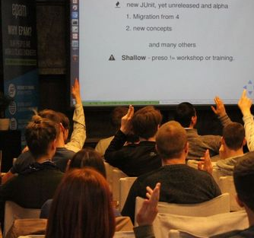
PathFinders
Organizing away-days and Christmas parties and town halls for 150+ participants.
Coordinating company presence on IT conferences: e.g. Domain Meeting, Forum IAB, Hosting Meeting, Forum e-Commerce, Targi eHandlu, Internet Beta.
Co-organizing 150+ participants fundraising gala dinner (Hong Kong).
Coordinating the presence of various clients on numerous job fairs.

Slide 12
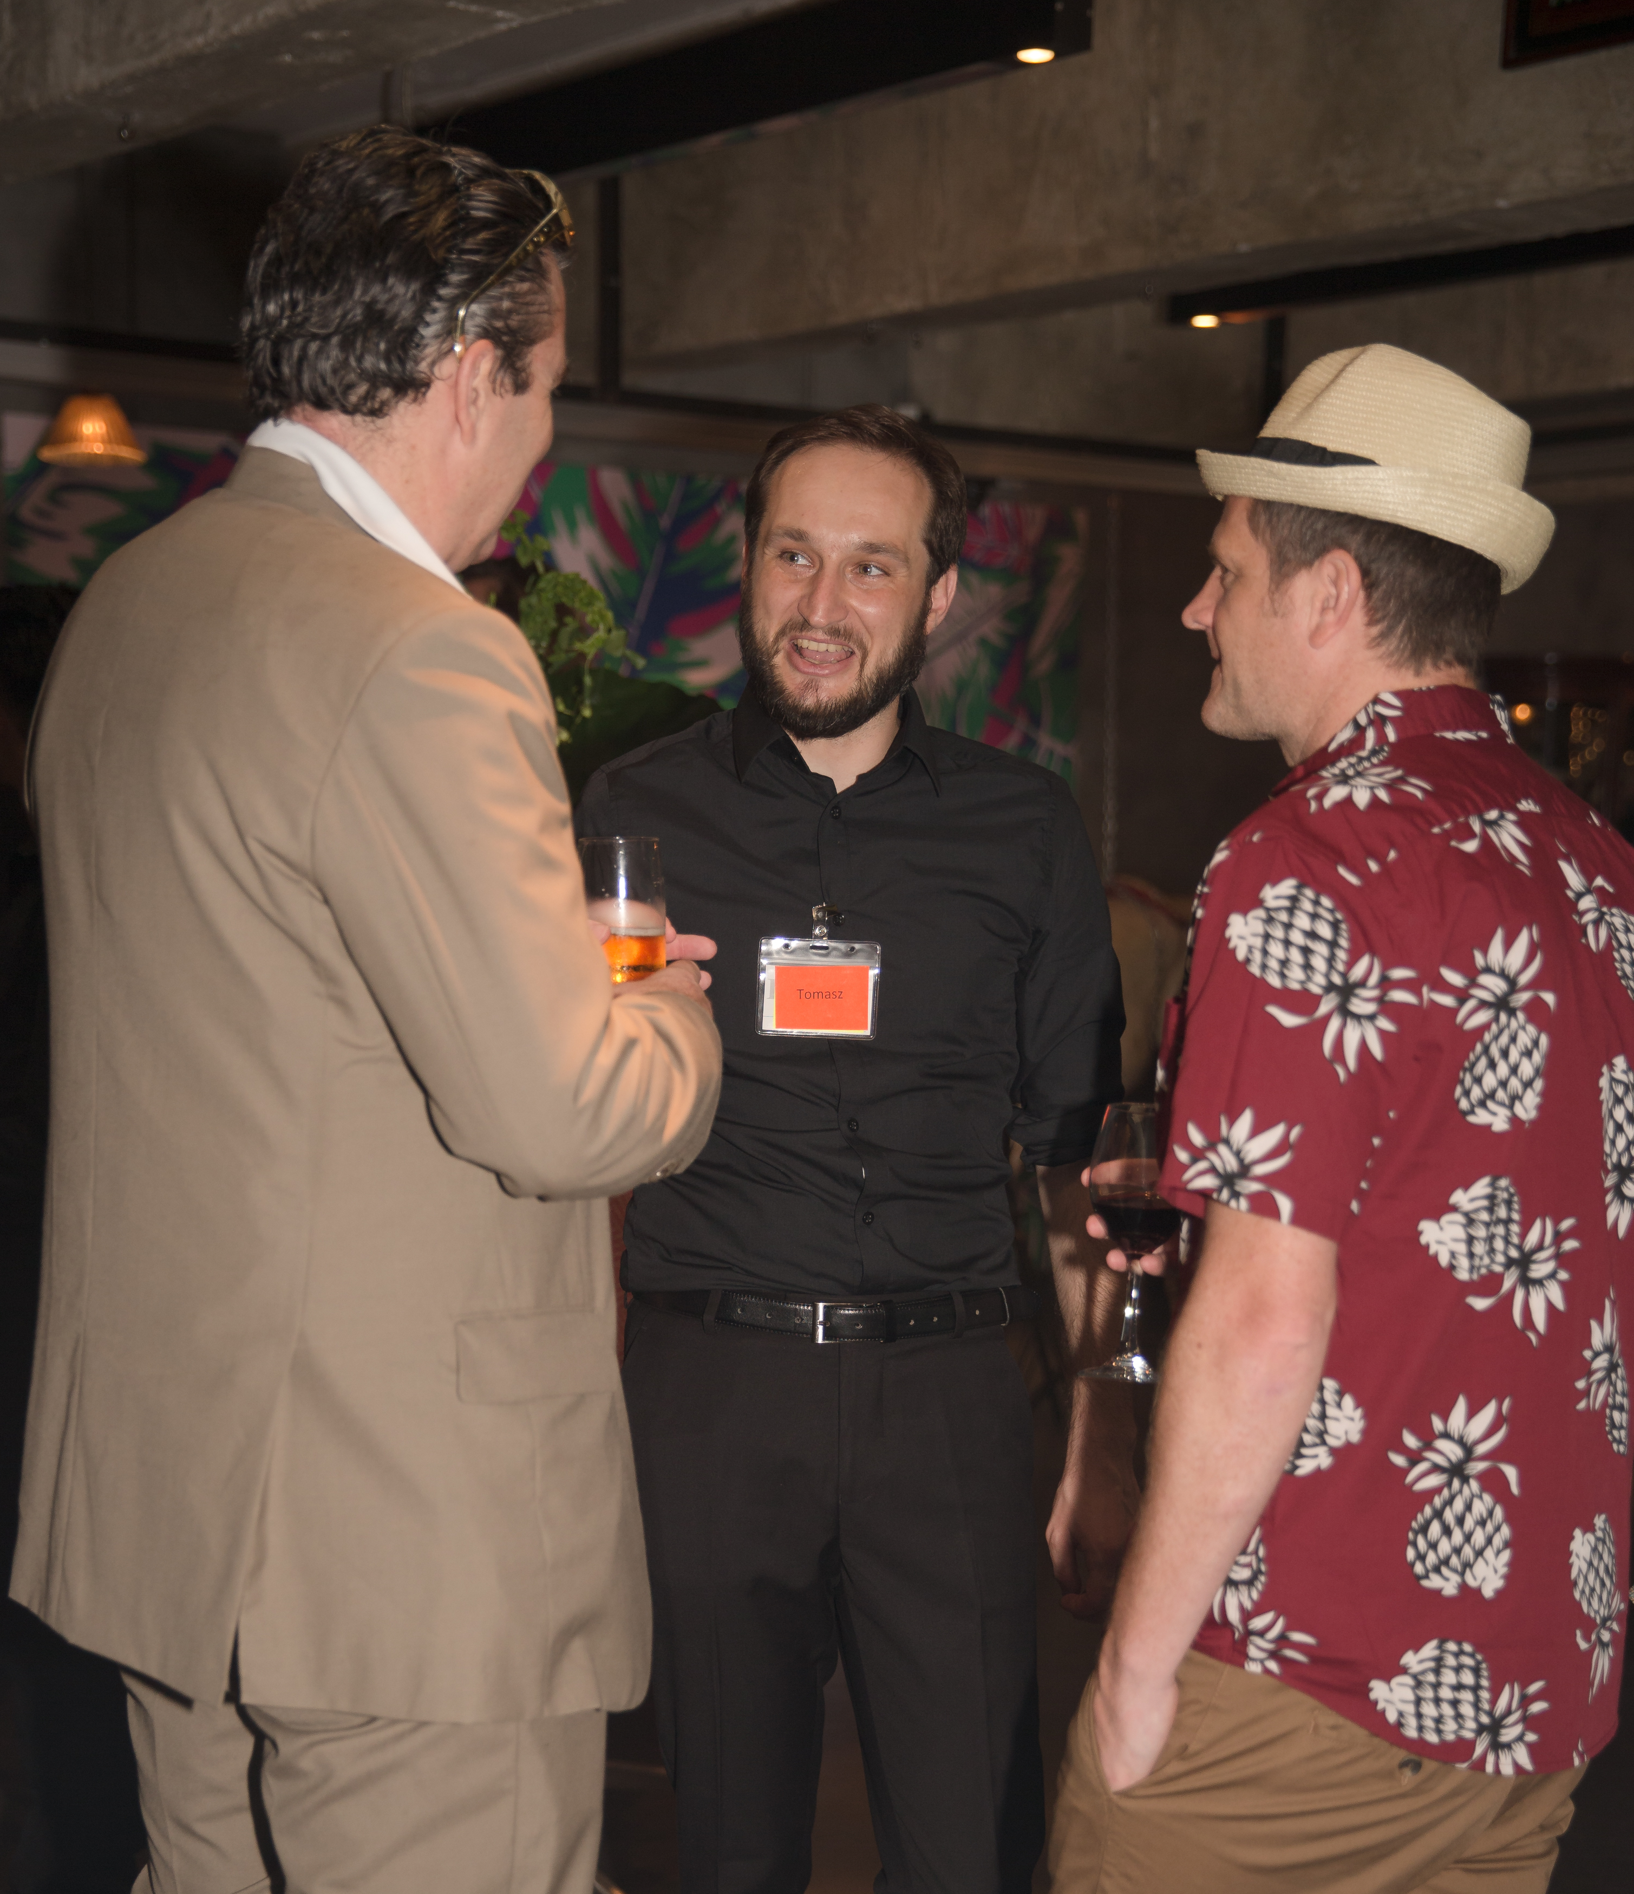
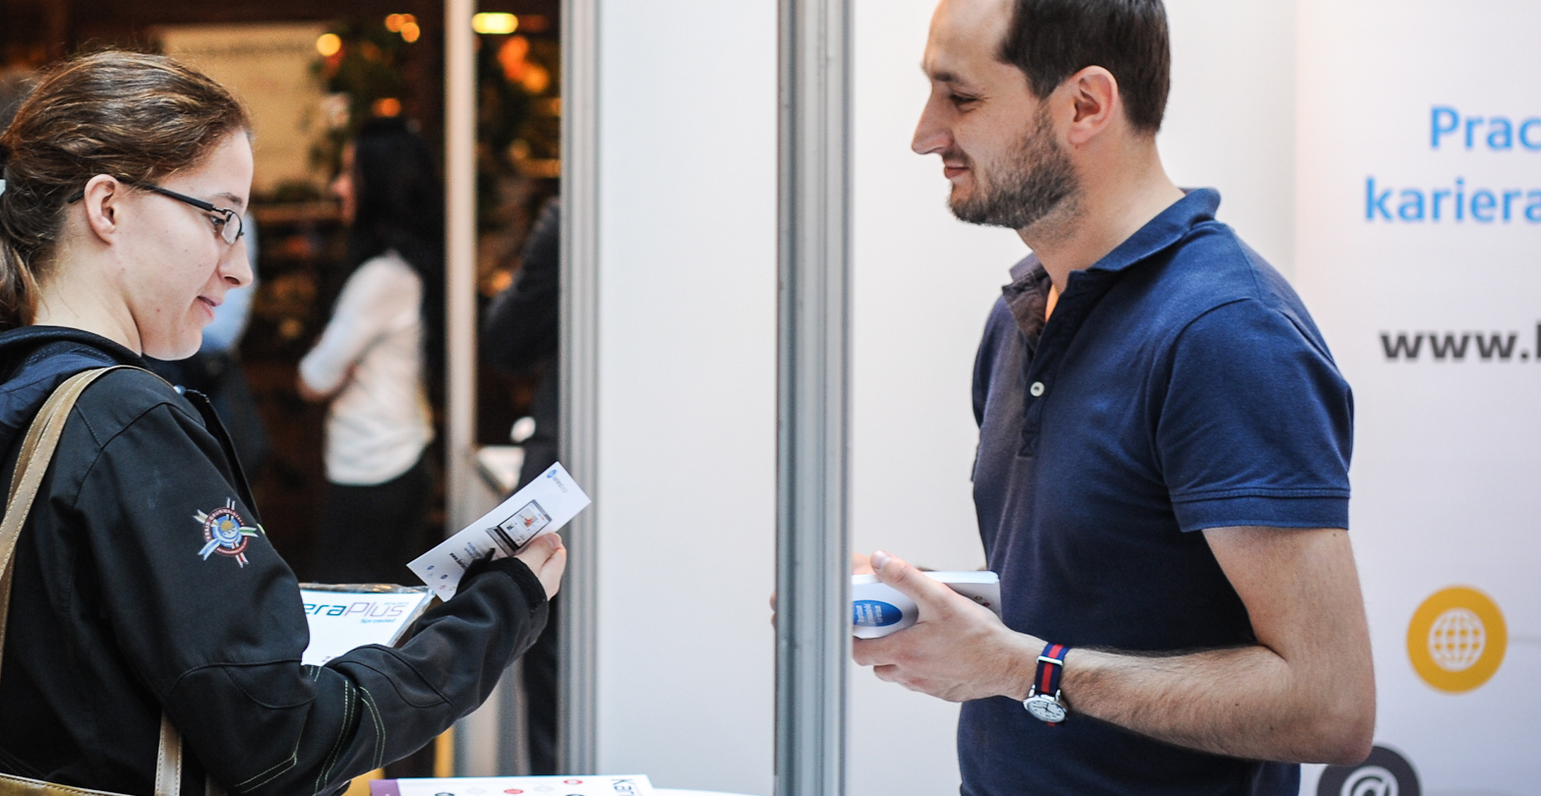
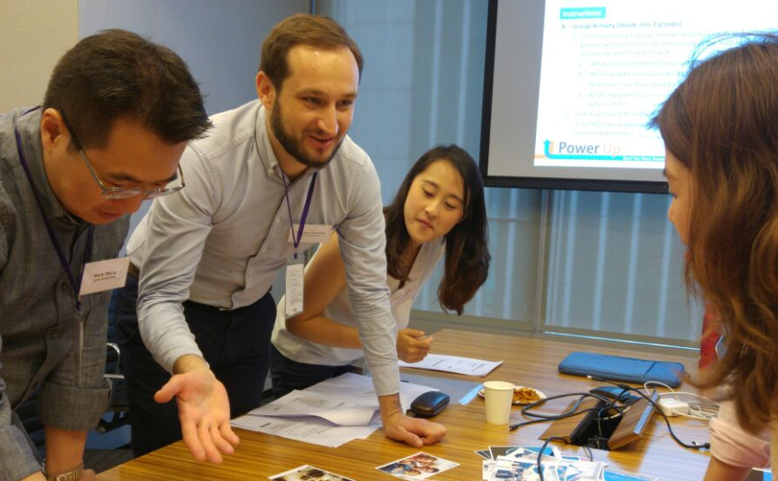

Slide 13

THANKS!
Any questions?
You can contact me at
tomekzawada@gmail.com
+48 508 163 069

